Slide 1
编译技术作业讲解-Regular Expression

Slide 2

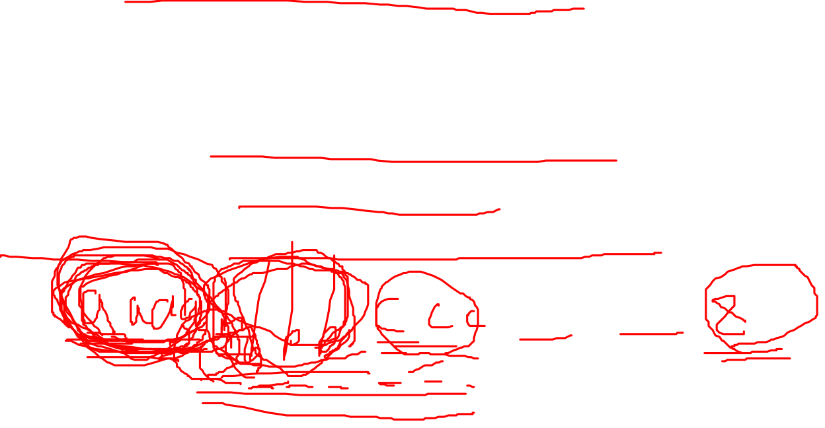
Regular Expression
Exercise 3.3.5 Write regular expression definitions for the following languages:
b)All strings of lowercase letters in which the letters are in ascending lexicographic order.
a*b*c*d*…w*x*y*z*

Slide 3
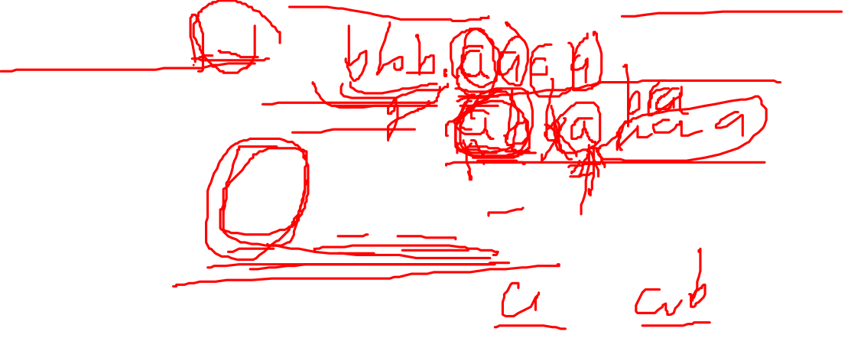
Regular Expression
Exercise 3.3.5
h) All strings of a's and b's that do not contain the substring abb.
b*(a|ab)*

